Slide 1


Capstone
Project

Slide 2



Personal BACKGROUND
Name :Udaykiran Pallanti
Past Experience : Experience in previous Trainings with Angular, Spring Boot, and Generative AI.
Qualification : Bachelor of Technology in CSE
Career Summary : A passionate and hardworking Quality Engineering enthusiast with hands-on experience in manual and automation testing of web and API applications. Skilled in using tools like Selenium, TestNG, Postman, and Newman. Able to write and execute test cases, find bugs, and ensure software works well.
www.collaberadigital.com

Slide 3


Problem Statement of the Capstone Project
Demonstrate end-to-end Quality Engineering skills with automated testing for web and APIs.
Develop scalable Selenium WebDriver UI tests using Page Object Model, logging, and assertions.
Create Postman API automation collections and run via Newman locally
Manage test execution, reporting, and tracking using Jira and Xray.
Optionally implement performance testing (JMeter).
Integrate tests and code into GitHub with branching strategies.

Slide 4
Reference Links :
Links
🔗 Web Application
https://opensource-demo.orangehrmlive.com/
🔗 API Base URL
https://fakestoreapi.com/
🔗 GitHub Repository
https://github.com/ASC11Uday/Udaykiran_CAPSTONE_COGNIXIA_WEB_API_MAY2025

Slide 5
Selenium Web UI Test Automation – Overview
Project Setup & Tools:
Java 11+, Maven, and TestNG used for test automation.
Selenium WebDriver for browser automation.
Log4j 1.x for logging test execution.
TestNG framework used for organizing and prioritizing test cases.
WebDriverManager for automatic driver management (Chrome & Edge).
Maven project structure followed with packages like pages, tests, testbase, and utils.
​
Framework Features & Best Practices
Page Object Model (POM) implemented for maintainability:
Separate classes for LoginPage, AddUserPage, BuzzPage, LogoutPage.
Reusable BaseTest class for setup and teardown (cross-browser ready).
Browser & headless mode controlled via config.properties.
Assertions added to validate key application behavior.
Logging used throughout tests to trace steps and outcomes.
TestNG XML used to organize and group test cases.

Slide 6
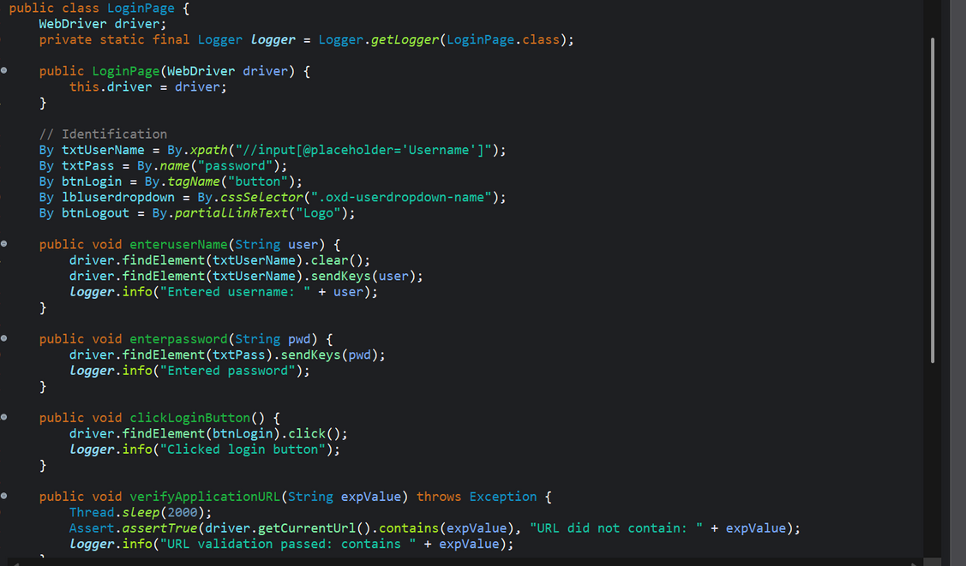
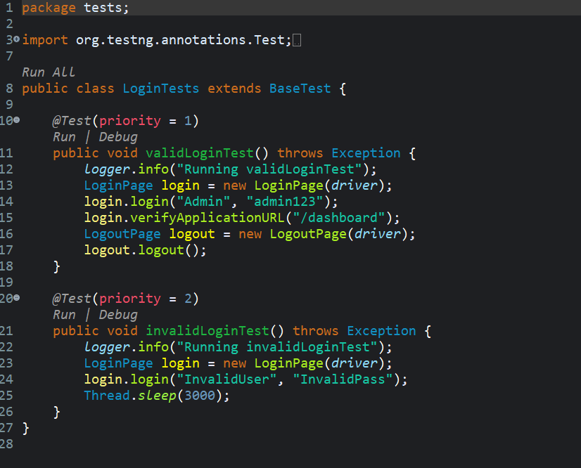
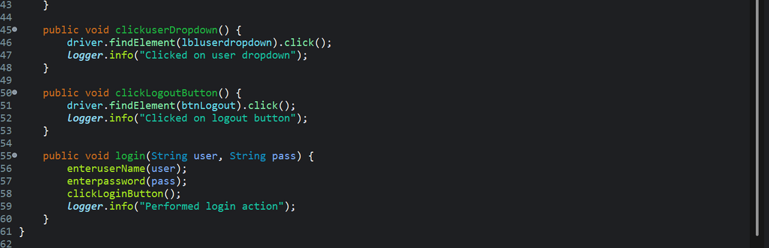
SELENIUM WEB UI TEST AUTOMATION- Login

Slide 7
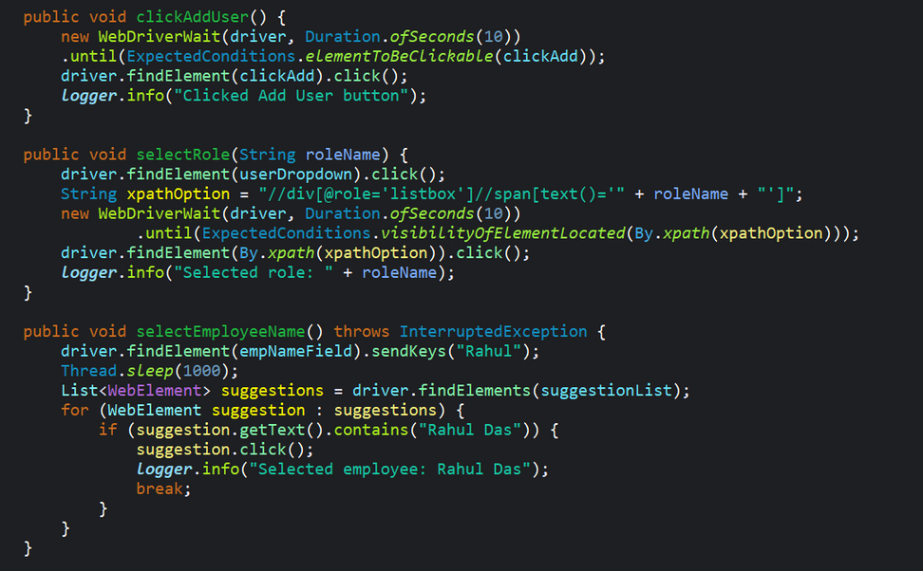
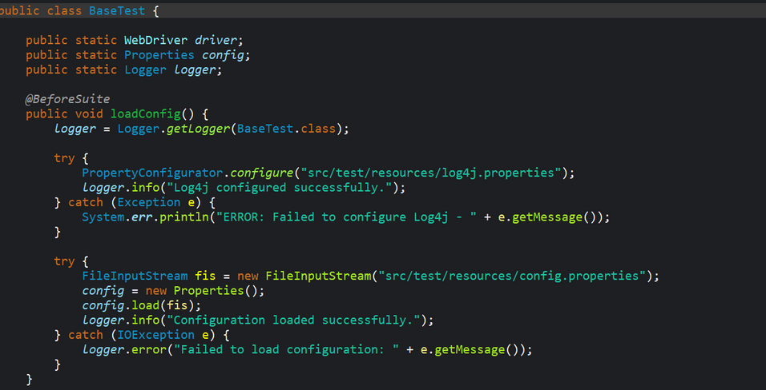
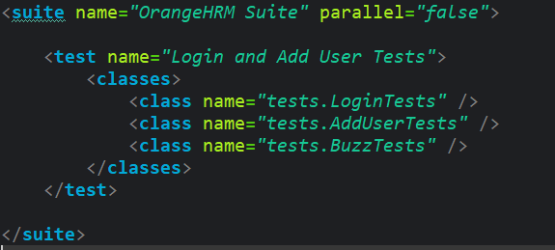
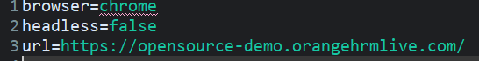
CODE SNIPPETS
AddUser
BaseTest
Testng.xml:
Config.properties

Slide 8
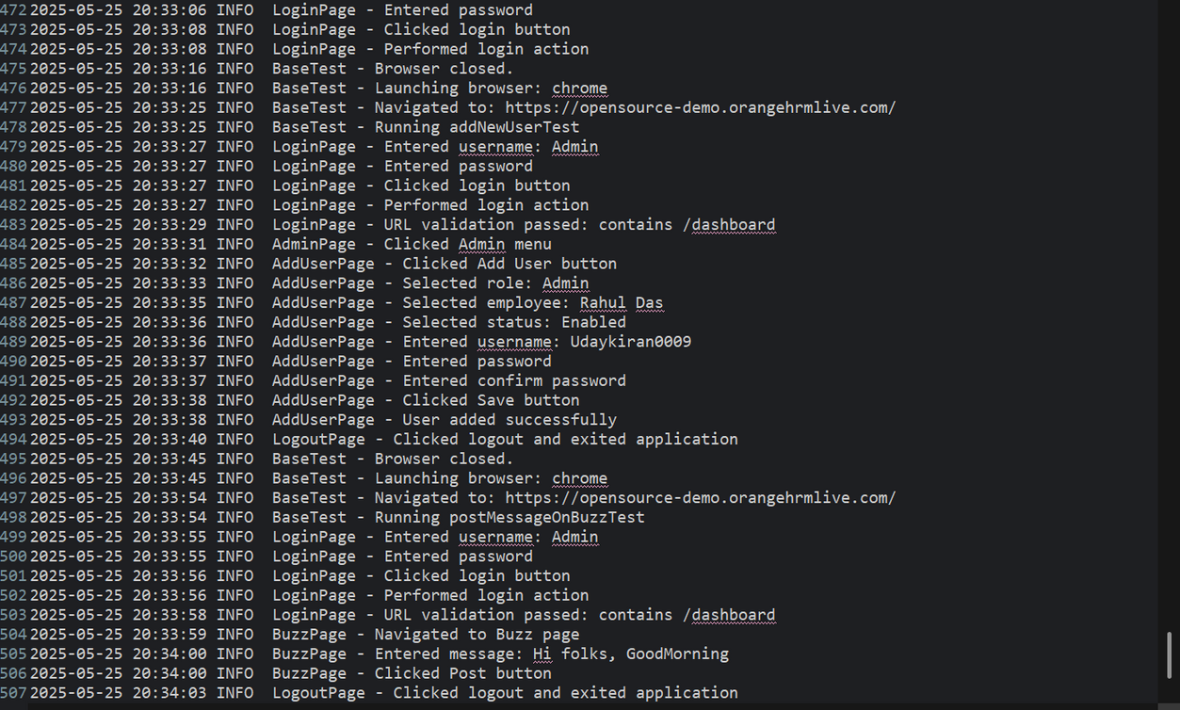
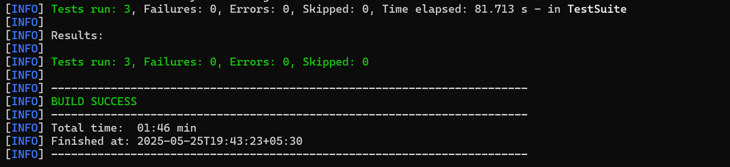
SELENIUM WEB UI TEST AUTOMATION
TEST EXECUTION FLOW USING LOGS .
USAGE OF PAGE OBJECT MODEL , ASSERTIONS AND LOGGING
DESIGNED CODE FOR BOTH HEADED AND HEADLESS MODE USING CONFIG.PROPERTIES FILE
•EXECUTED TEST FROM TESTNG_CAPSTONE.XML FILE

Slide 9
API Automation – Postman + Newman (CLI)
Tech Stack: Postman • Newman CLI
Requests Automated:
GET All Products
POST Create Product
PUT Update Product by ID
PATCH Product by ID
DELETE Product by ID
Validation Checks:
HTTP Status Codes: 200, 201
Response Body Content: e.g., Apple iPhone 14
Response Time: under 2000ms
Header Assertions: Content-Type: application/json
Generates HTML report using htmlextra reporter
Stores output at newman/report.html
API https://fakestoreapi.com/

Slide 10
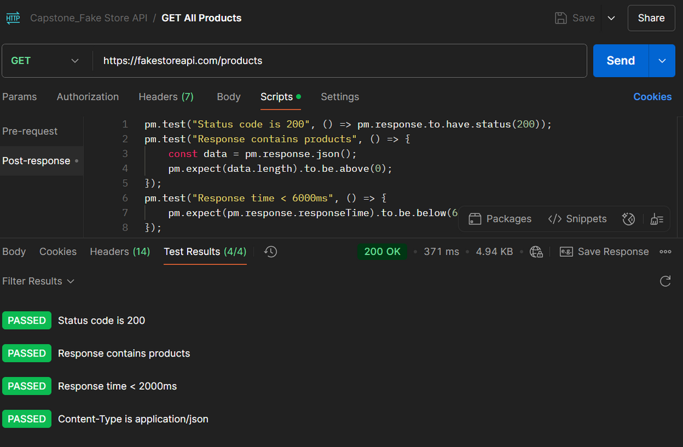
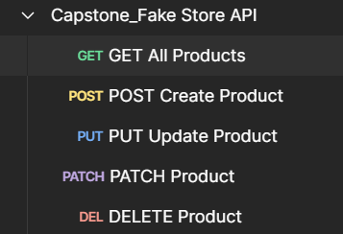
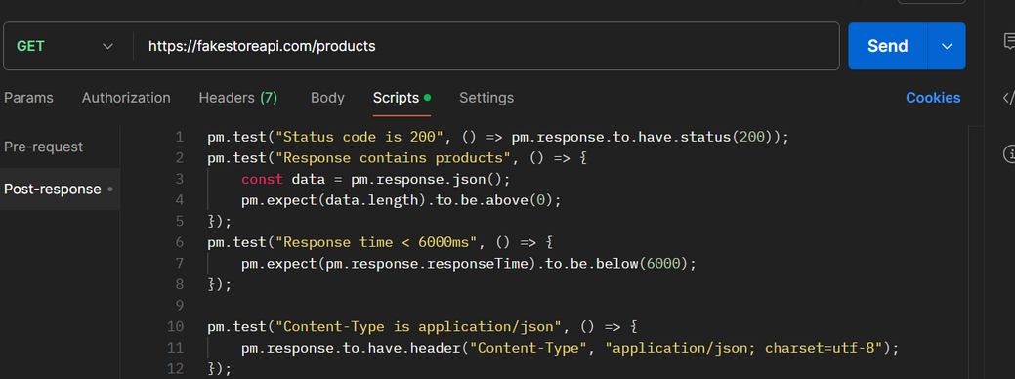
API AUTOMATION WITH POSTMAN AND NEWMAN
Validation Scripts:

Slide 11
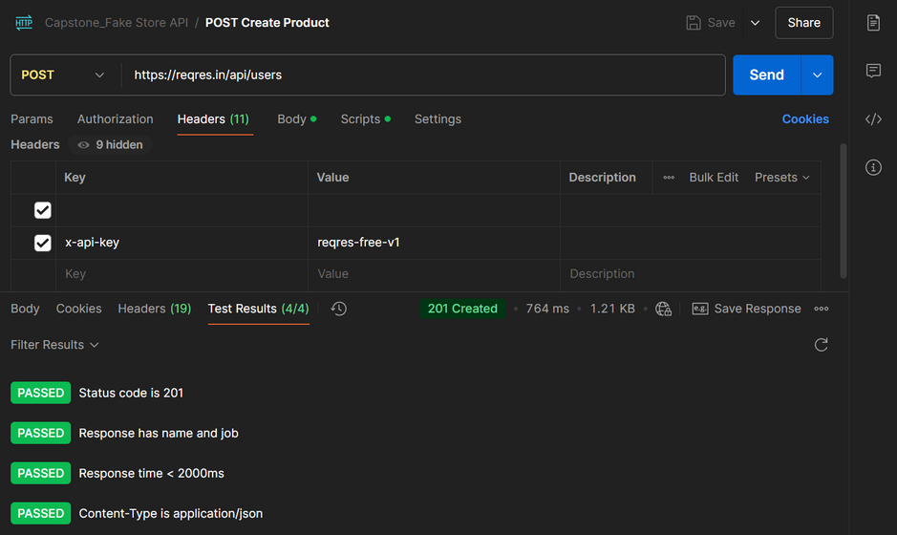
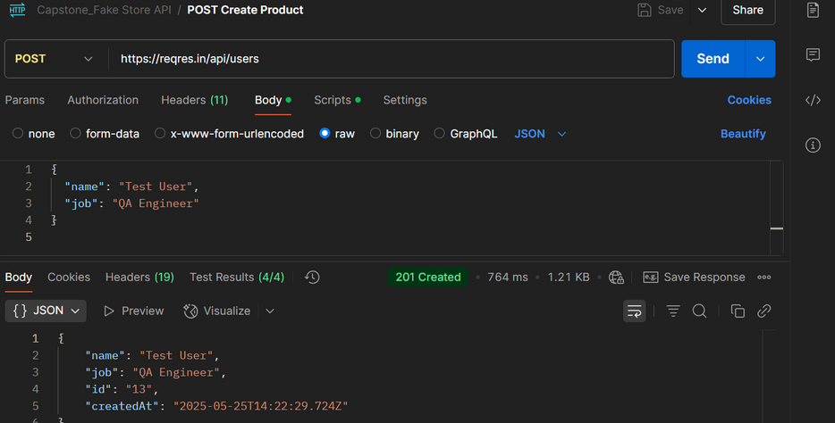
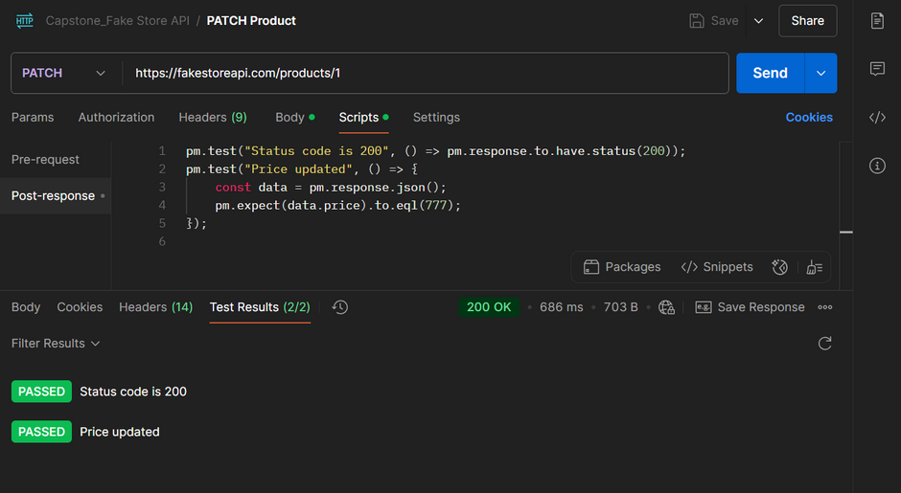
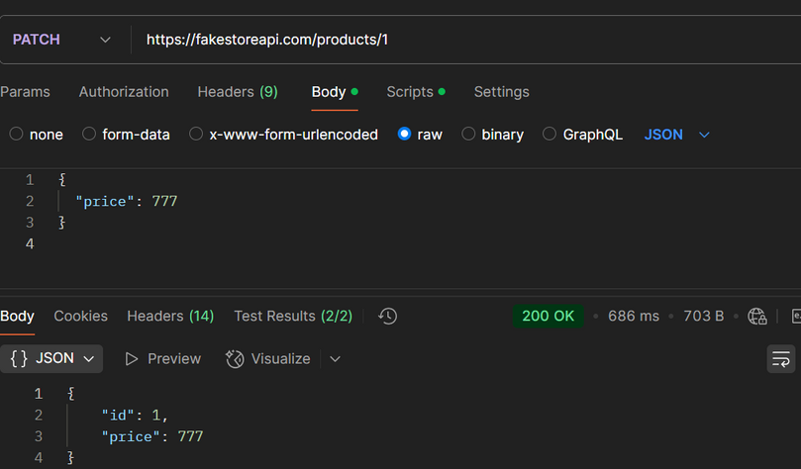
API AUTOMATION WITH POSTMAN AND NEWMAN
Post Request:
Patch Request:

Slide 12
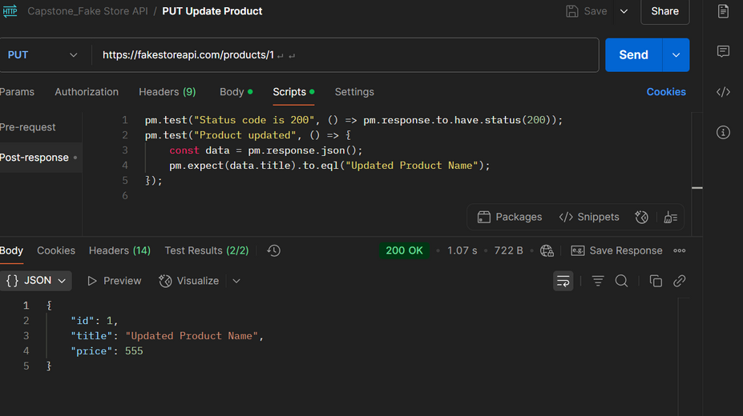
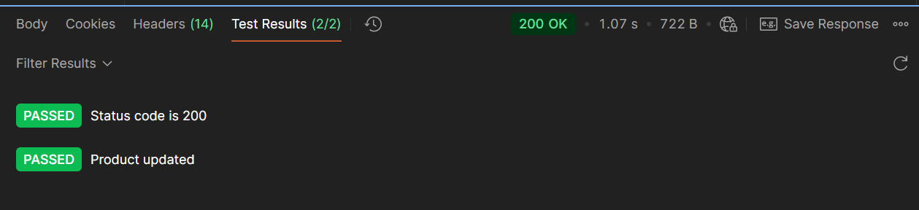
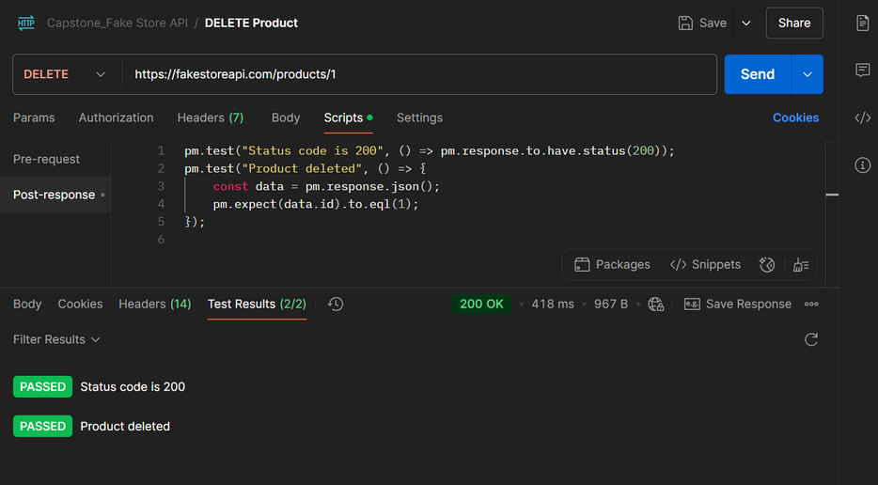
API AUTOMATION WITH POSTMAN AND NEWMAN
Put Request:
Delete Request:

Slide 13
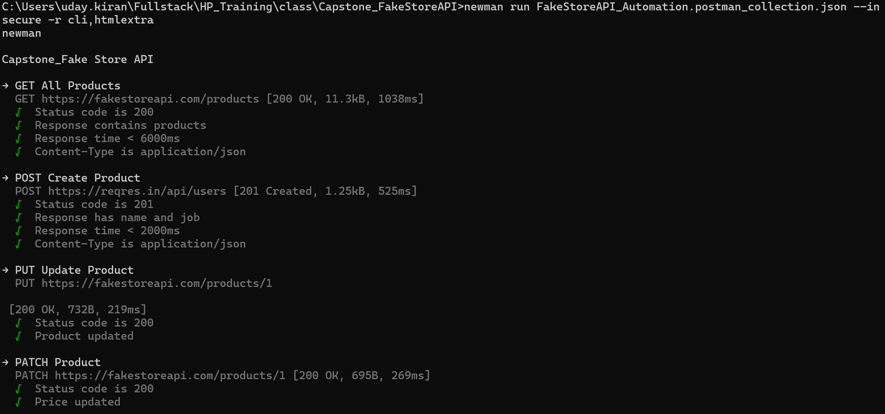
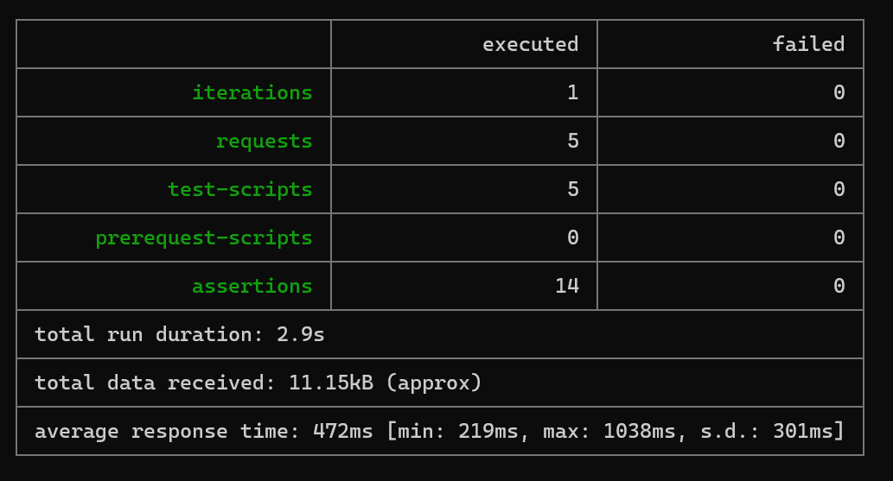
EXECUTING THE EXPORTED COLLECTION IN CMD FROM POSTMAN USING NEWMAN

Slide 14
Performance Testing – Apache JMeter
Tool: Apache JMeter (.jmx scripts)
Purpose: Load & performance testing for APIs and web applications
Test Scenario Configuration:
Users: 10 virtual users
Ramp-up Time: 1 second
Delay Between Requests: 10 seconds
Test Duration: 120 seconds
CLI Execution & Report Generation:
jmeter.bat -n -t "path/to/test.jmx" -l "path/to/results.log" -e -o "path/to/HTMLReport"
Headless test execution
Generates detailed HTML reports for analysis
API :https://reqres.in/

Slide 15
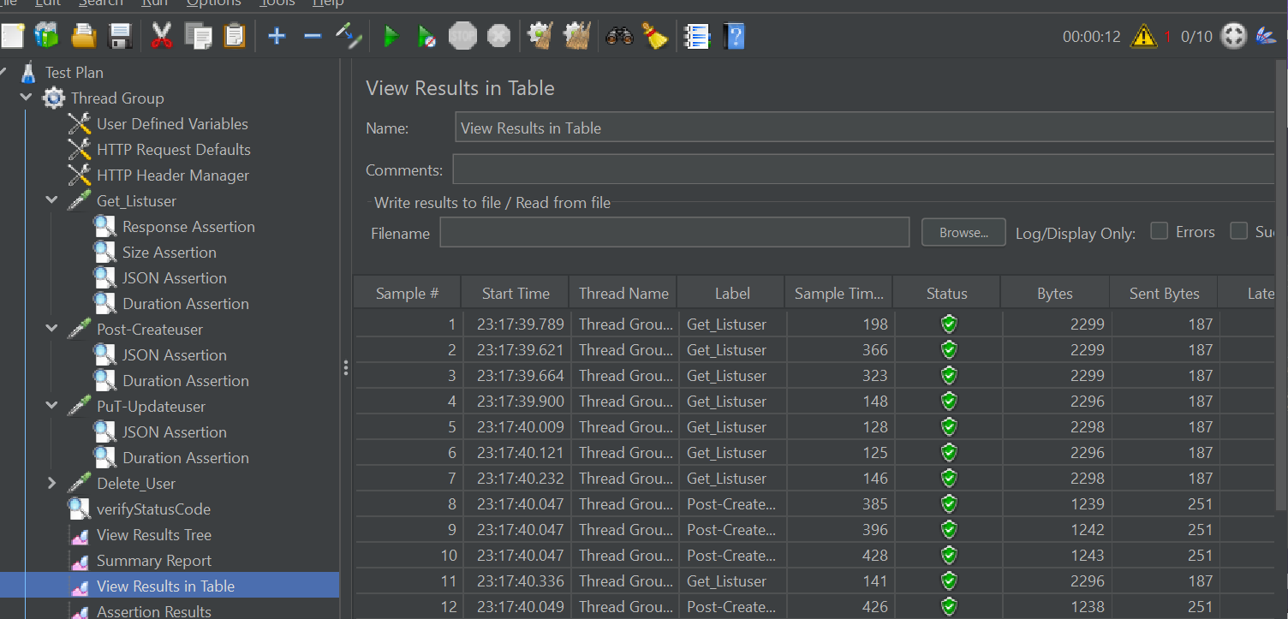
Responses of the API JMeter with Result Table

Slide 16
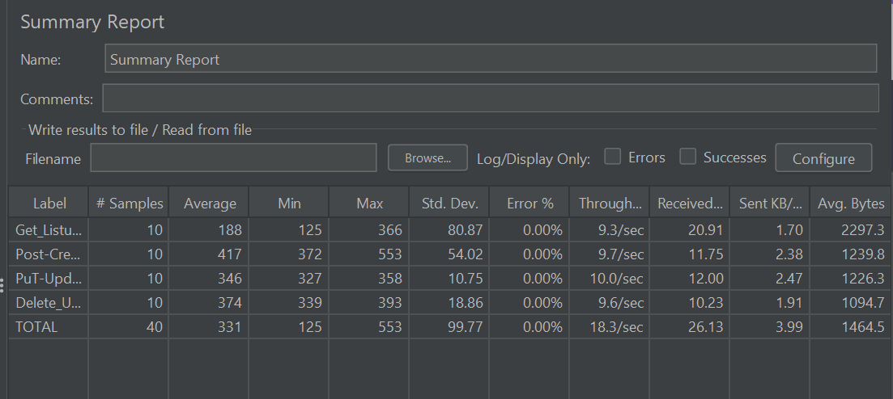
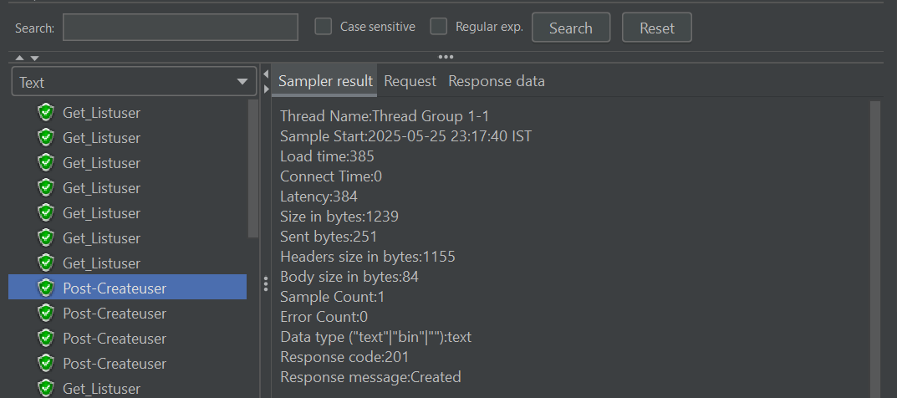
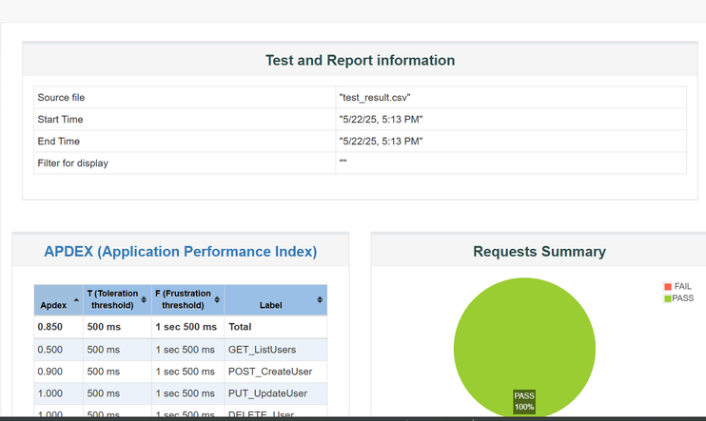
Summary Report & Result Tree
HTML reports:

Slide 17
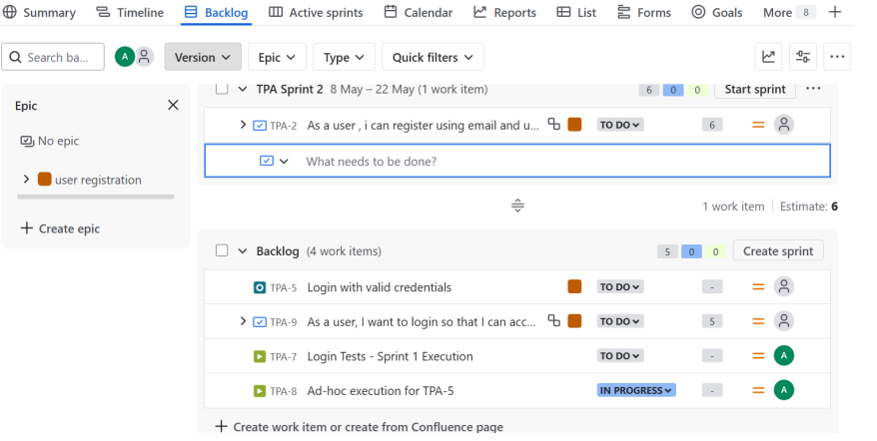
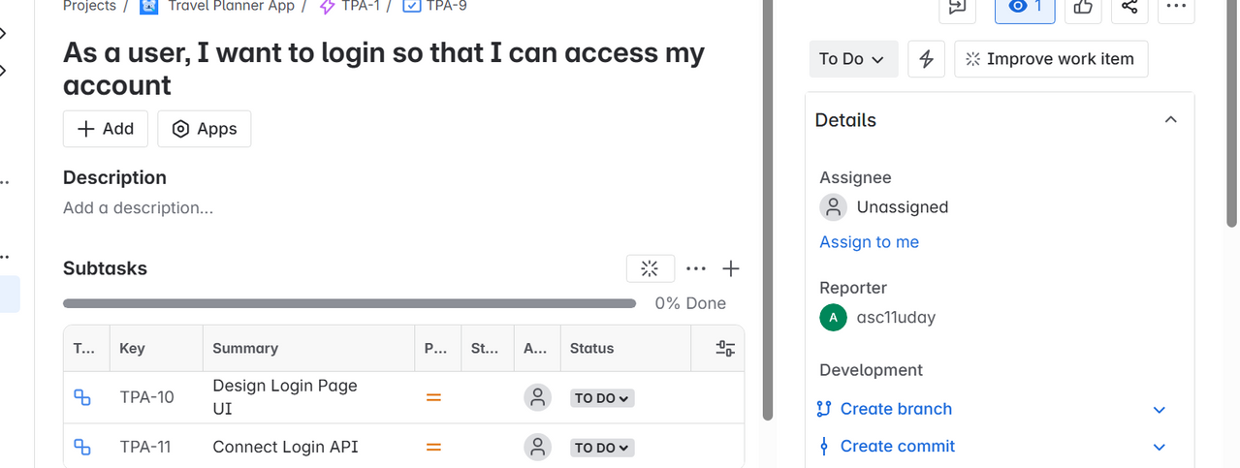
JIRA DASHBOARD
Sprint Summary & Active Sprint View
Subtasks for login story

Slide 18
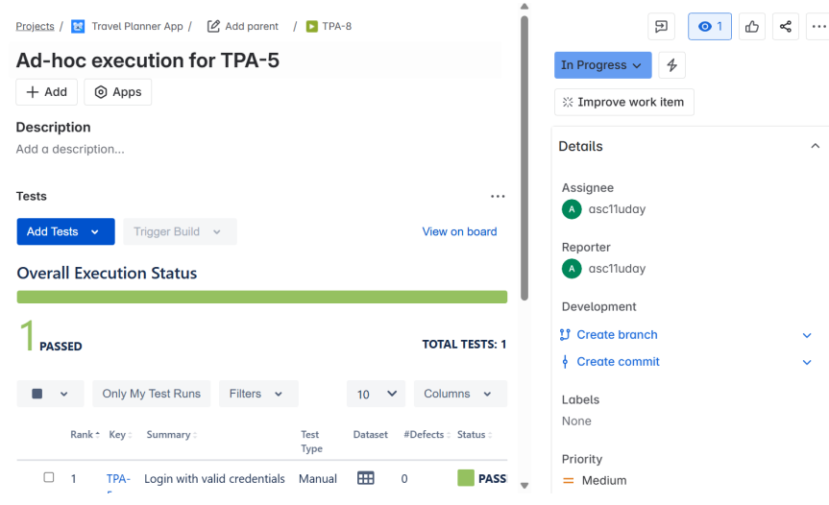
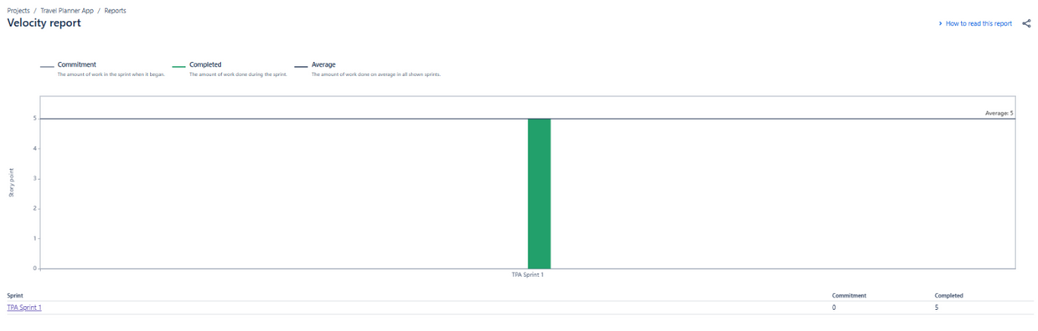
•TEST EXECUTION RESULTS USING XRAY
Velocity report

Slide 19
Conclusion
Gained hands-on experience in end-to-end Quality Engineering, including Manual, UI, APIand Performance Testing..
Designed structured Selenium Web UI test cases using Java, TestNG, and Page Object Model (POM) to ensure maintainability and scalability.
Implemented key functional test scenarios (e.g., login, user creation, Buzz posting), including assertions, Log4j logging.
Enabled headless/headed test execution dynamically using a config.properties file, ideal for both local runs and CI/CD pipelines.
Executed API tests via Newman CLI, generating detailed HTML reports (htmlextra) for better result visibility and traceability.
.
Managed test cases, execution tracking, and defect management using JIRA and Xray, aligning test efforts with agile sprints..

Slide 20

Thank You

